Slide 1







SpaceX Falcon 9 first stage Landing Prediction
JOSE RAMON LAGUNA
30 October 2024

Slide 2



OUTLINE
Executive Summary
Introduction
Methodology
Results
Visualization – Charts
Dashboard
Discussion
Findings & Implications
Conclusion
Appendix

Slide 3

EXECUTIVE SUMMARY
SpaceX has gained worldwide attention for a series of historic milestones. SpaceX advertises Falcon 9 rocket launches on its website with a cost of 62 million dollars whereas other providers cost upward of 165 million dollars each, much of the savings is because Space X can reuse the first stage.
In this report, we will show descriptive analysis and machine learning models. We found that decision tree is the best model.

Slide 4

INTRODUCTION
In this capstone, we will predict if the Falcon 9 first stage will land successfully. SpaceX advertises Falcon 9 rocket launches on its website with a cost of 62 million dollars; other providers cost upward of 165 million dollars each, much of the savings is because SpaceX can reuse the first stage. Therefore if we can determine if the first stage will land, we can determine the cost of a launch. This information can be used if an alternate company wants to bid against SpaceX for a rocket launch.

Slide 5

METHODOLOGY
Descriptive Analysis
Data Wrangling
EDA
Machine Learning Methods
Logistic Regression
SVM
Decision Tree
KNN

Slide 6
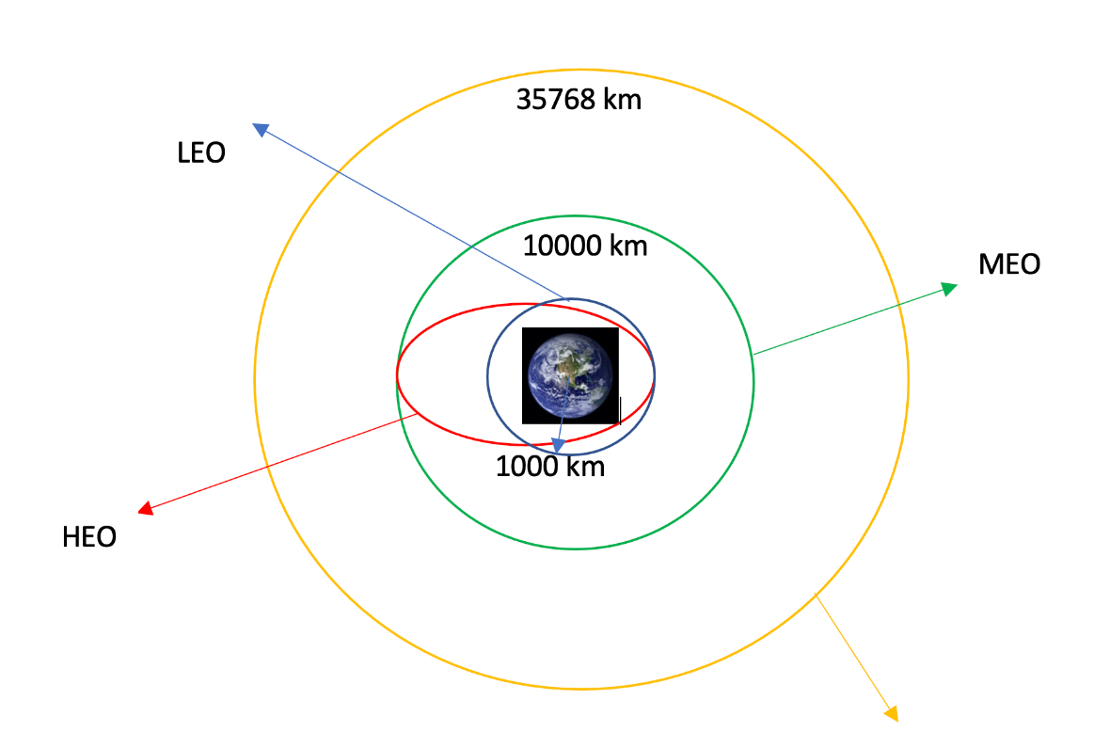
RESULTS

Slide 7
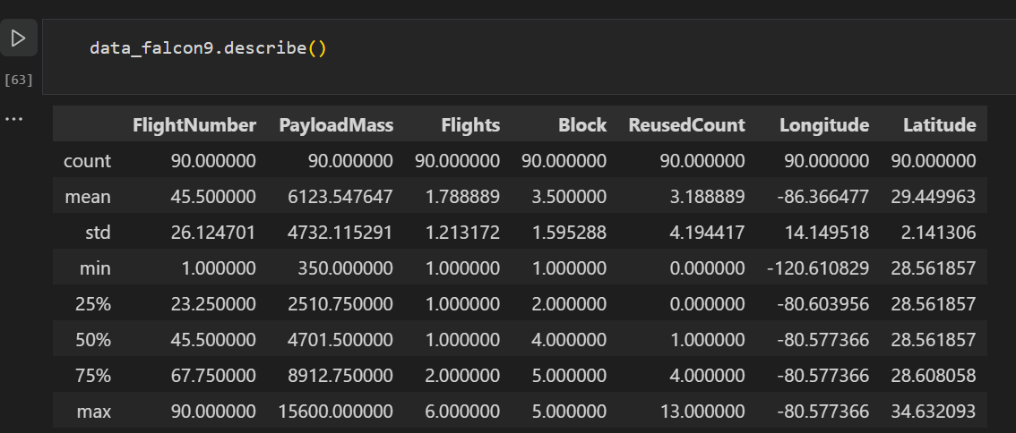
Descriptive Statistics

Slide 8
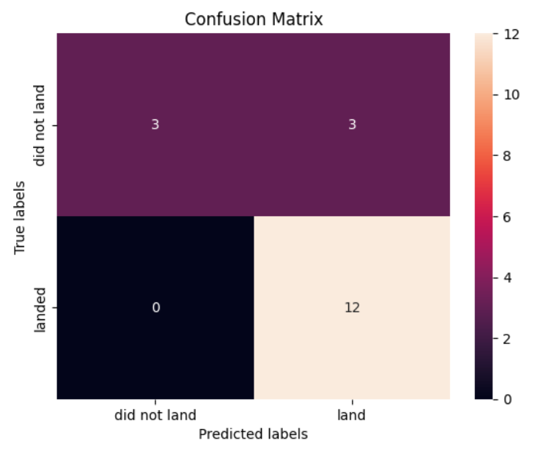
Confusion Matrix

Slide 9
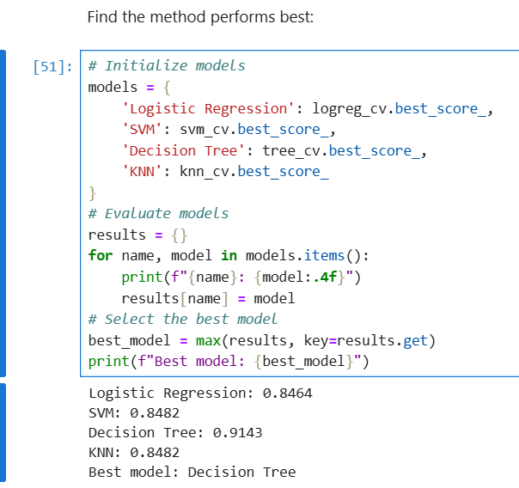
Best Model: Decision Tree

Slide 10

DASHBOARD
<The GitHub link of the Cognos dashboard goes here.>

Slide 11
DISCUSSION

Slide 12

CONCLUSION
Decision Tree is best model

Slide 13

APPENDIX
Include any relevant additional charts, or tables that you may have created during the analysis phase.

